Slide 1
Roll System Mobile
User Manual

Slide 2
System Requirement
Server Requirement
Hardware:
Personal computers for developing with the minimum configuration:
CPU Core 2 Duo 2.0GHz, 4GB of RAM, 300GB of hard disk, and internet.
Software:
Opearating System: Window 7
Web Server: Microsoft IIS
Database: Microsoft SQL 2008 R2
Mobile Requirement
Android 4.0 or above
Camera 3.0 Megapixed or above

Slide 3
Image Data Requirement
Each students must has at least 8 images as training images, for acceptable accuracy.

Slide 4










Image Data Requirement
The image should be clear without too much noise.
Two eyes should be as the center.
The face must look front, or tilt ~5-10 degree.
Gray image is also okay
Example of good image data

Slide 5









Sample Data Set
Sample data of a student (From 8-20 images), should contains:
70-80% of frontal face, with different brightness, facial expression....
20% of side face, with different brightness.
Example of good sample data set:

Slide 6










Images should not be used
Avoid using images that:
Too blur, too dark or too bright.
Contains big noise, or error.
The face is covered by something.
Tilt with high degree (>20%)
Example of images should not be used

Slide 7
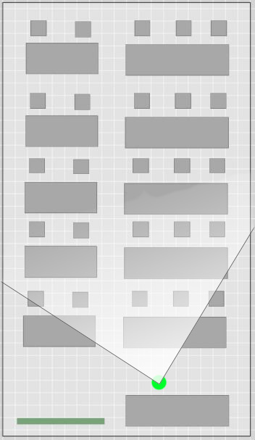
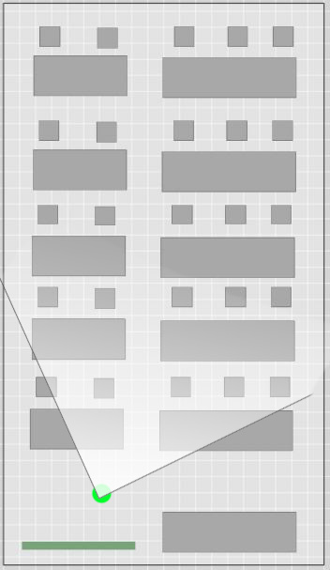
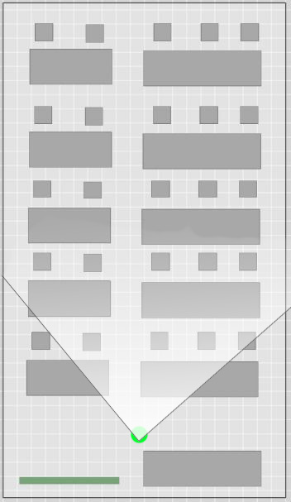
Position & Angle
For small classrooms

Slide 8
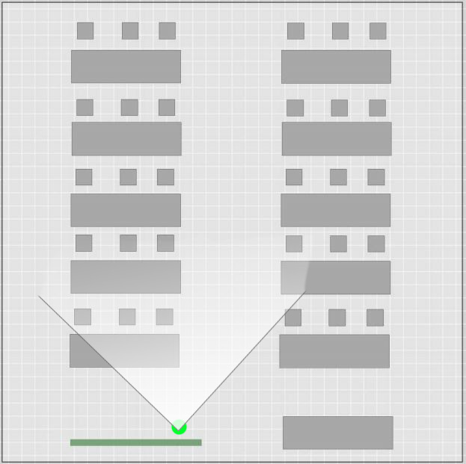


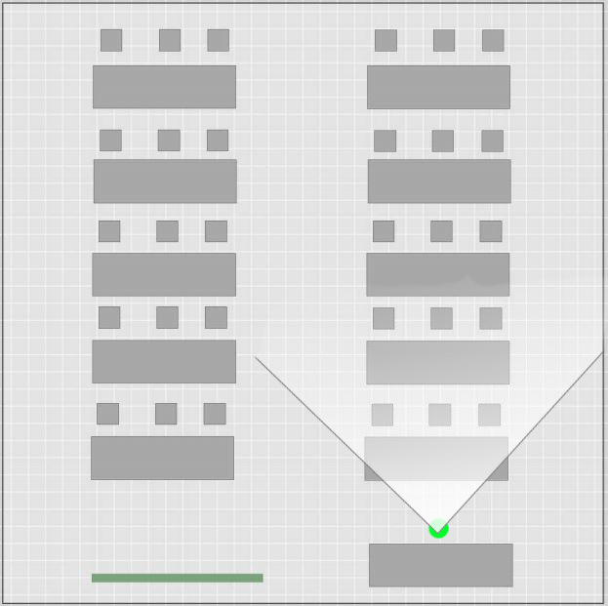
Position & Angle
For bigger classrooms

Slide 9
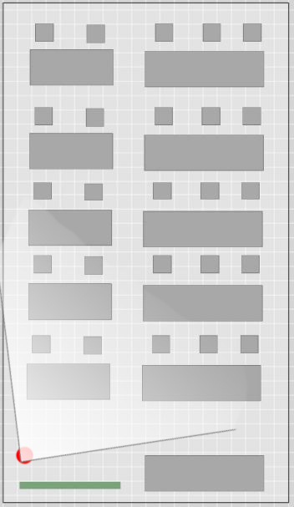

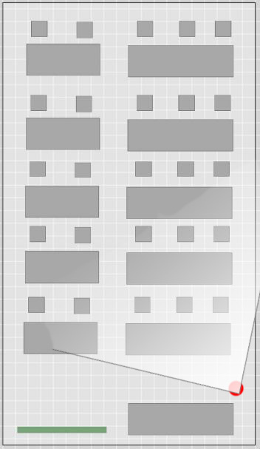
Avoid Position & Angle
For small classrooms

Slide 10
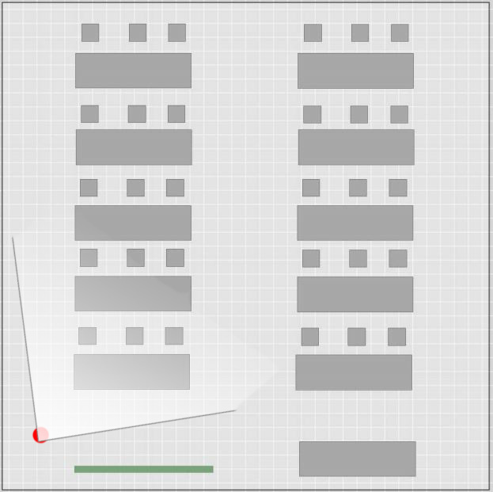
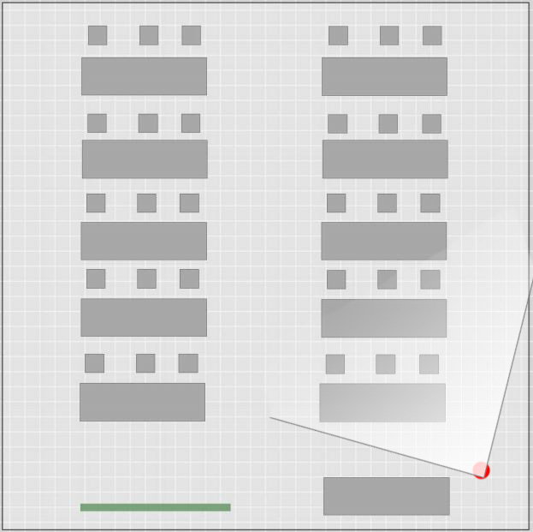
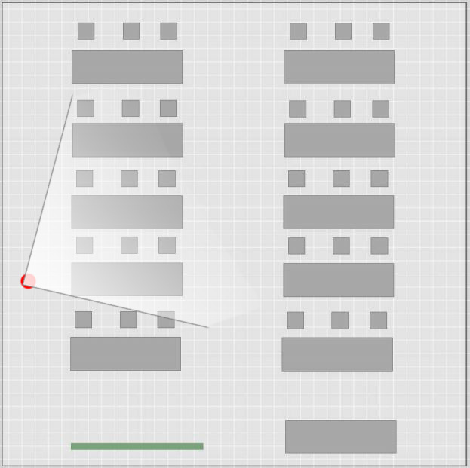
Avoid Position & Angle
For bigger classrooms

Slide 11
Number of picture to take
According to test result, with class of 15-20 students, the number of required image is 4-6 images.
With bigger class, the number of required image is 6-10 images.

Slide 12
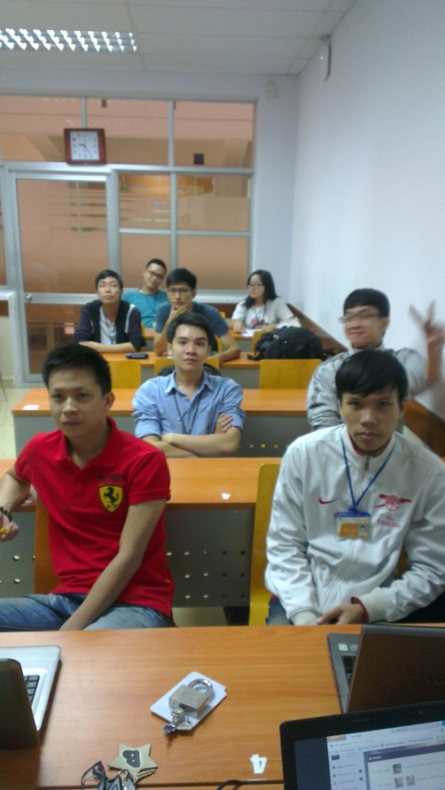
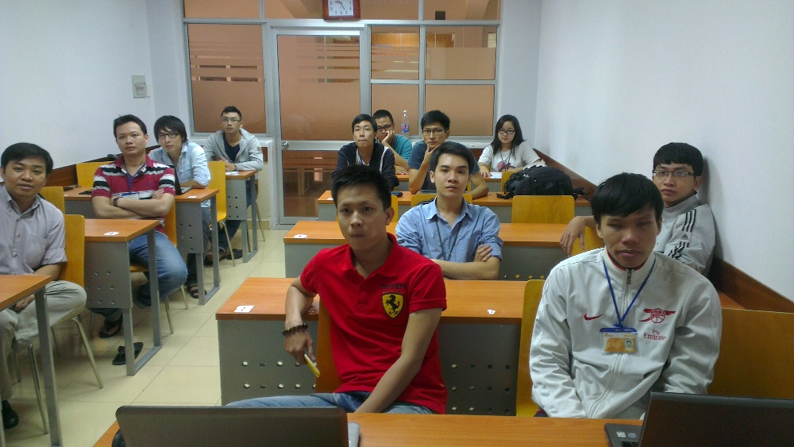
Another requirements
The classroom should has good brightness.
The student should look to front, look at the camera.
Example:

Slide 13
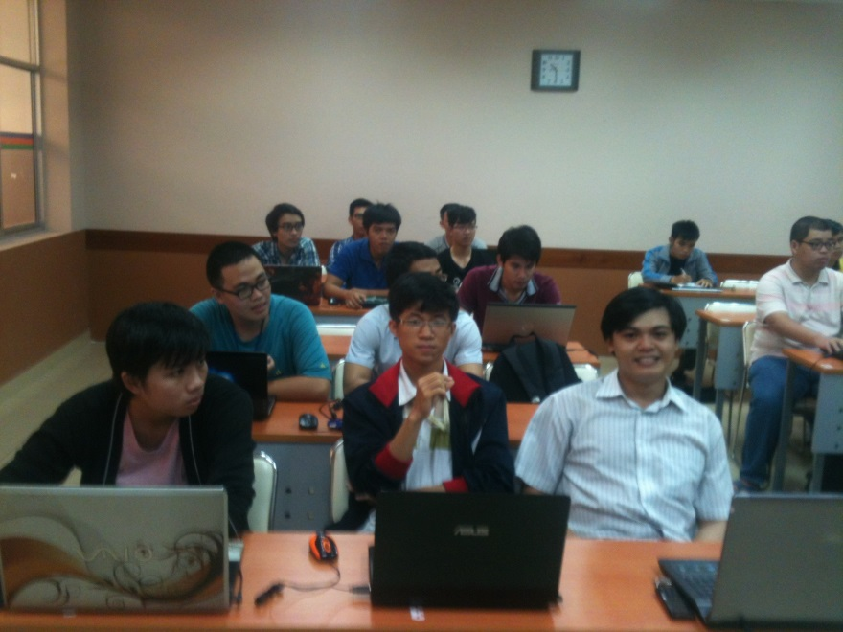
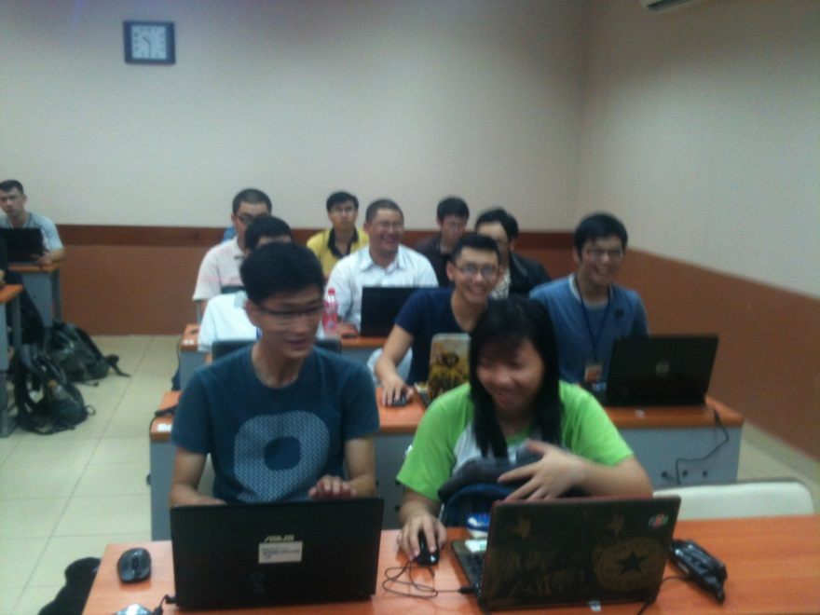
Another requirements
In some situation, the student on the front cover the face of back students, this lead to lower recognition rate.
Solution for better recognition rate:
Take more images in different angles.
Tell front student to lower their head.
Use the “learning” modules.

